Slide 1
LNG ABUJA II
TANK SOUNDING AND WATER FIGURES APP
Designed and built by
Eneotu Joseph (Engineering cadet)
Email: eneotujoe@gmail.com

Slide 2
INTRODUCTION
This tank sounding and water figures app is a productivity tool that is created to ease conversion of tank sounding levels to volume, and calculation of fresh water figures.
The app has four tabs which are; sounding converter, sounding table, water figures and interpolation. The first three tabs are customized for use on LNG Abuja II and LNG Abalamabie.
The interpolation tab can be used on any other vessel.
The app can further be upgraded for more functionalities.

Slide 3
BENEFIT
Elimination of human error due to manual calculation
Accuracy of calculated values
Reduction in time spent on manual calculation

Slide 4
SECURITY
The app completely safe and secure
No internet connection is required to run it
No database is connected to it
No software installation is required
No third-party software framework and library were downloaded in order to build or run this app

Slide 5




TECHNOLOGY
HTML and CSS and JavaScript were used to build this application.
It utilizes JavaScript V8 engine in the browser to make computations.
It is independent of any other software.

Slide 6



SYSTEM REQUIREMENT
Just like Aurora Web and Blueline, it requires only browser; Chrome, FireFox and Edge without additional configuration.
It is simply an HTML file that opens in the browser when double-clicked.
It is completely offline and works without internet connection.

Slide 7
HOW TO USE
The app works in a very simple way;
Launch App => Input Values => Convert/Calculate => Result => Done
The results are returned and displayed on the user interface as shown below:

Slide 8
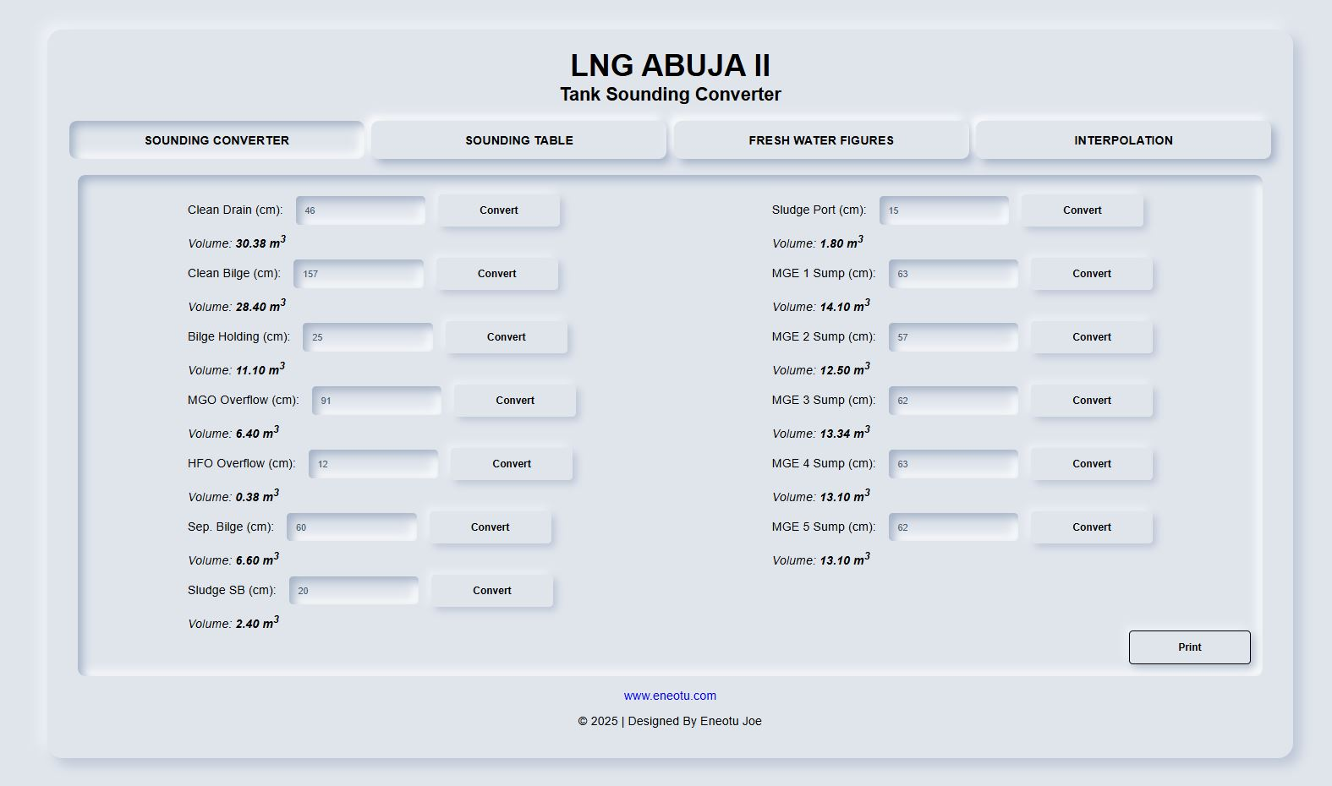
HOW TO USE
Double-click on the HTML file to launch the app.
Enter tank soundings on the input fields and click convert button.

Slide 9
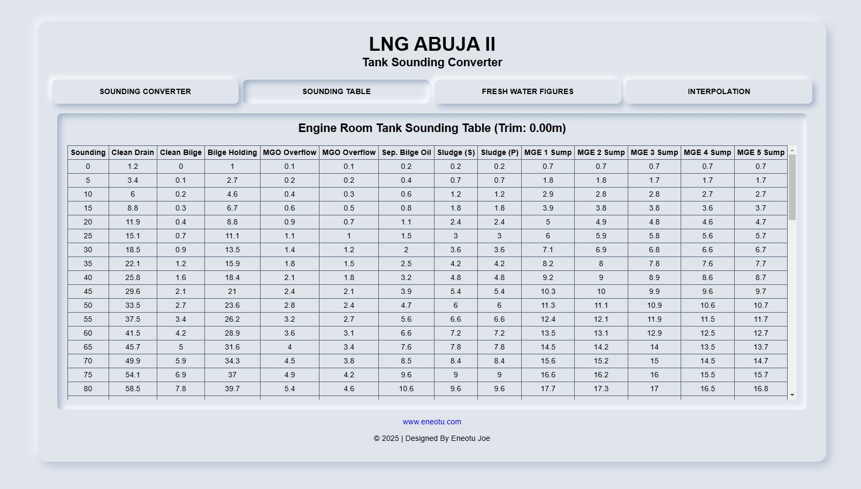
HOW TO USE
The JavaScript algorithm takes data from the tank sounding table to the volume base on predefined formula

Slide 10
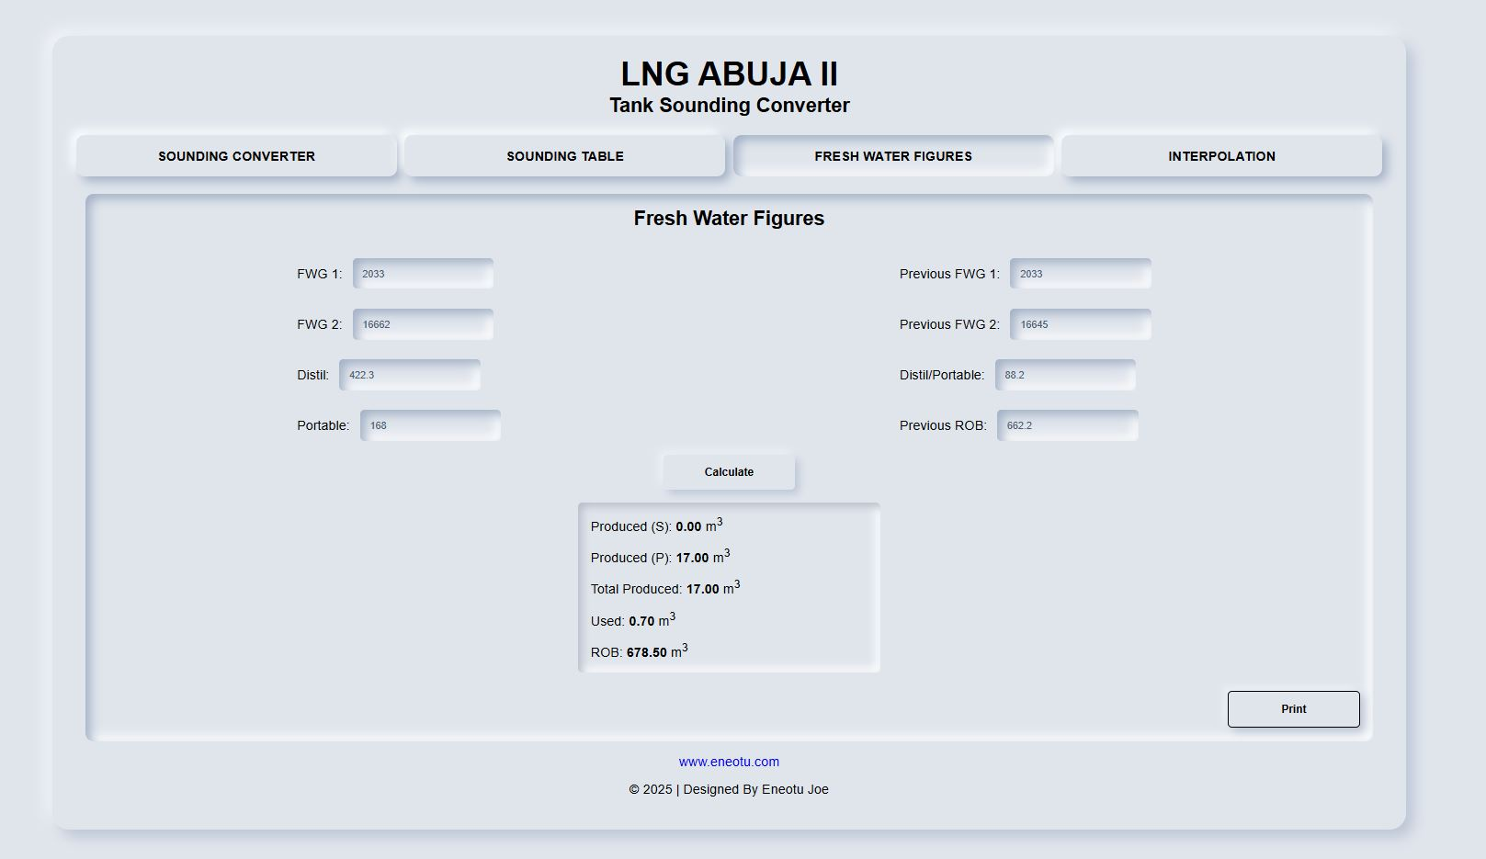
HOW TO USE
Enter water figures on the input fields and click calculate button.

Slide 11
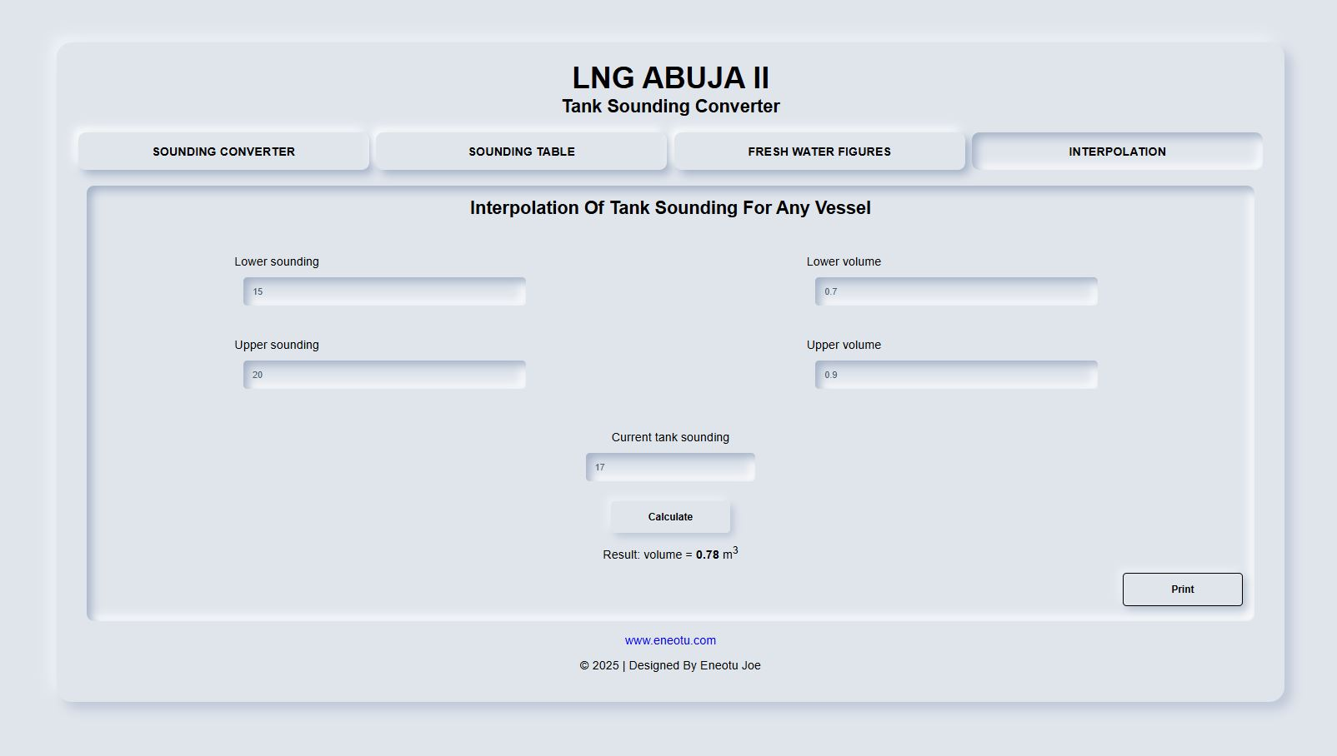
HOW TO USE
Generic use case: The interpolation page can be used for sounding on any other vessel.

